Slide 1
CT216: Introduction to Communication Systems
Yash Vasavada
Winter 2024
DA-IICT
Lecture 6
Modulation Schemes
1st April 2024

Slide 2
Types of Communication Systems
Analog Communication Systems: directly transfers messages that are continuous in time and in voltages (e.g., microphone output)
Historically, first to be developed
Many radio stations today are still analog systems
Two important types: Amplitude Modulation (AM), Frequency Modulation (FM)
Digital Communication Systems: transfers messages that are discrete (i.e., one of a finite number of messages)
Can deal with analog information sources (their output has to be discretized both in time and in voltages)
May either transmit the discrete messages directly or convert them to analog signal before transmission. The later scheme is often preferred since it facilitates long-distance communication

Slide 3
Block Diagram of An Analog Communication Transceiver
Analog Signal IN
Modulator
Channel
Analog Signal OUT
Demodulator

Slide 4
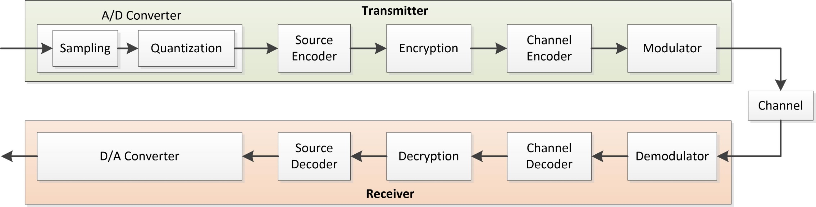
Block Diagram of a Digital Communication Transceiver
Analog Signal IN
Analog Signal OUT

Slide 5
Advantages of Digital Communication Systems over Analog Communication Systems
Any noise introduces irrecoverable distortion in the analog signal. In comparison, the a digital receiver needs to distinguish only a finite number of transmitted data. Thus, it is possible to completely remove the effect of noise.
Many performance enhancing signal processing techniques, such as source coding, channel coding, encryption, etc., require digital processing.
Digital technology, for which the primary currency is bits (Digital Integrated Circuits (ICs), and in general, the computers and the smartphones and their networks), has become very powerful and are inexpensive to manufacture.
Digital Communications allows integration of voice, video and data on a single packet networking system.
Easier to preserve privacy by encryption of digital messages
Compared to analog communication systems, digital communications provides a better tradeoff of bandwidth efficiency against energy efficiency (i.e., exchange the power with the bandwidth).

Slide 6
Next several slides demonstrate what a digital communication system can do, which an analog communication system is not capable of doing.

Slide 7
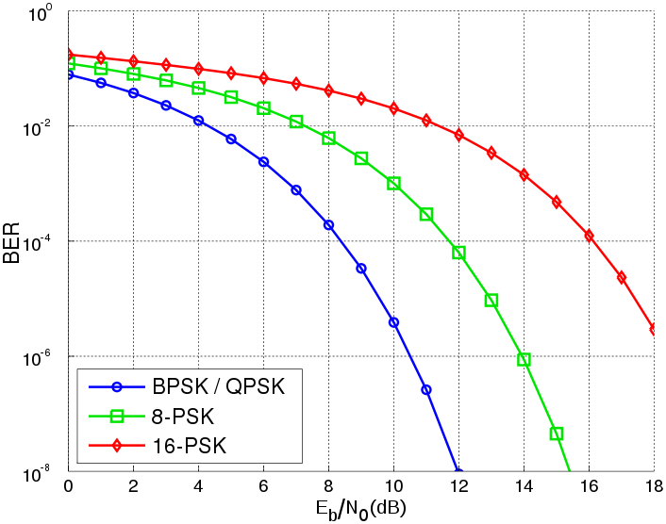
Performance of Digital Communication Systems
Prior to the discovery of the modern coding methods (Turbo, LDPC, Polar codes), the BER and the BLER performance followed a waterfall curve
BER: bit error rate or probability of bit error
BLER: block error rate, or probability of block/packet/frame error
https://commons.wikimedia.org/w/index.php?curid=2196675

Slide 8
LDPC Coding Performance
The LDPC and related codes turn the wireless channel in to an on-off channel
If SNR is below a threshold, the channel is OFF
BLER is close to one
Else it is ON
BLER is near zero
Coding Gain
✗
✓
https://commons.wikimedia.org/w/index.php?curid=2196675

Slide 9
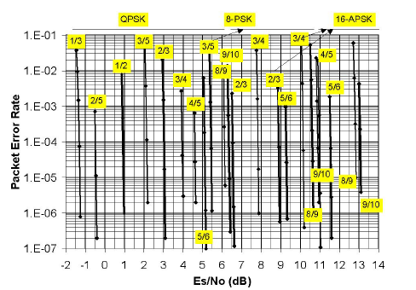
Consider these code rates

Slide 10
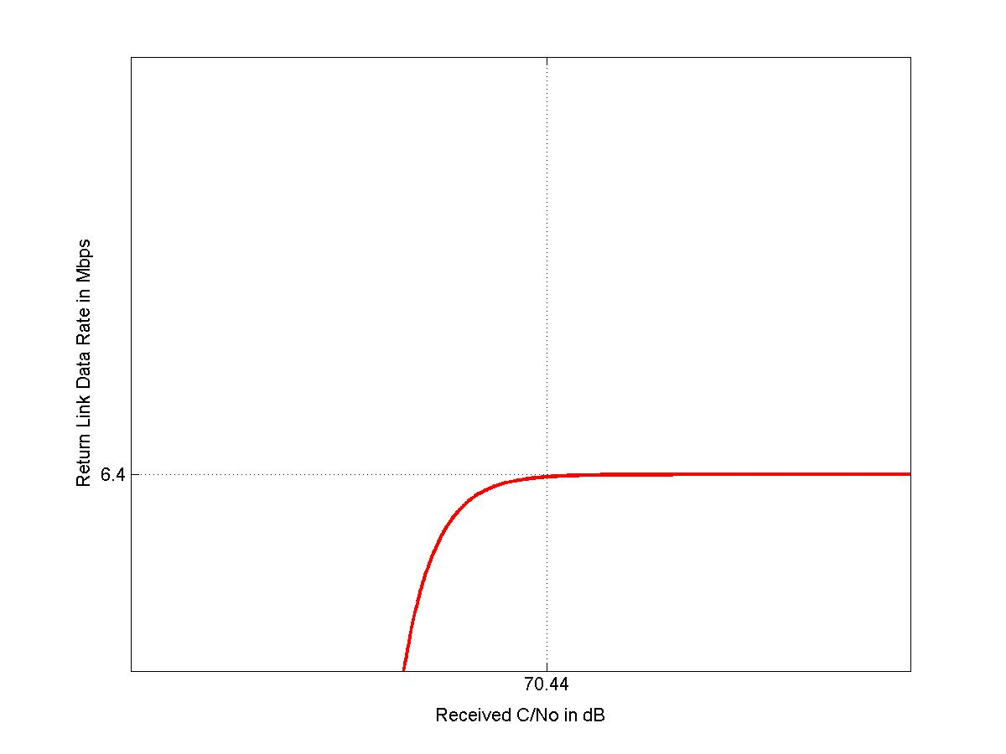
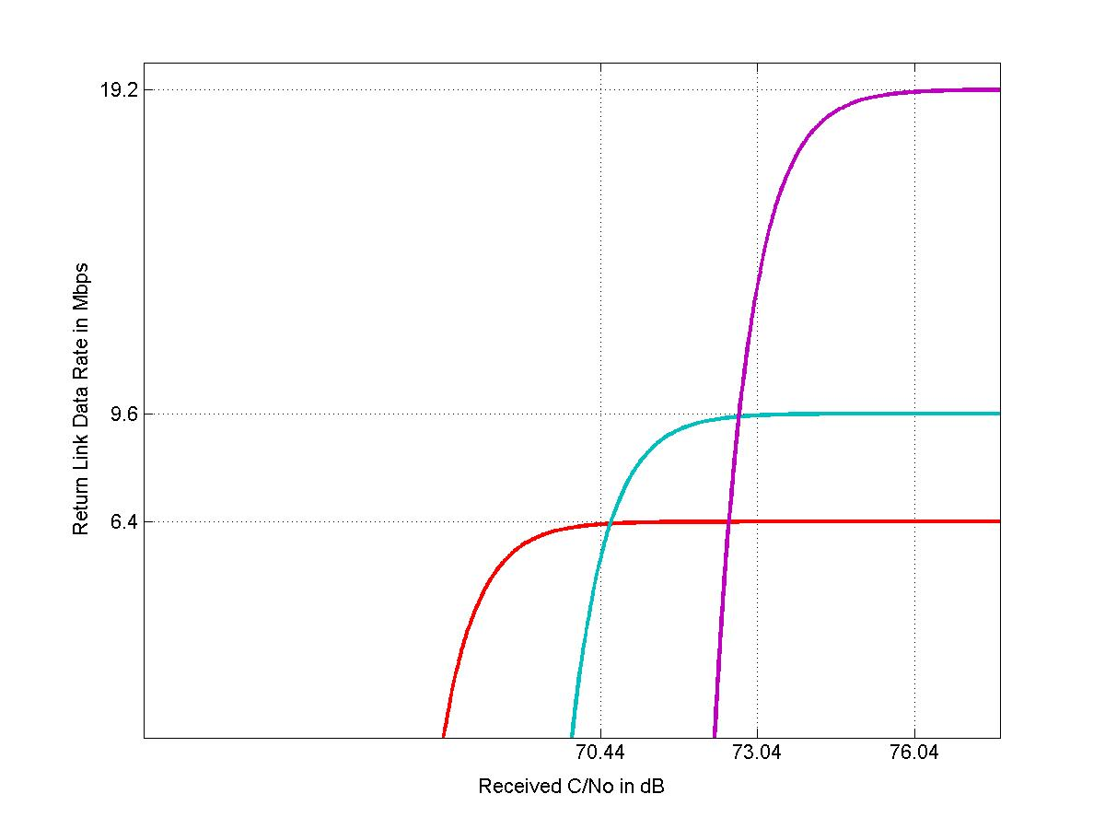
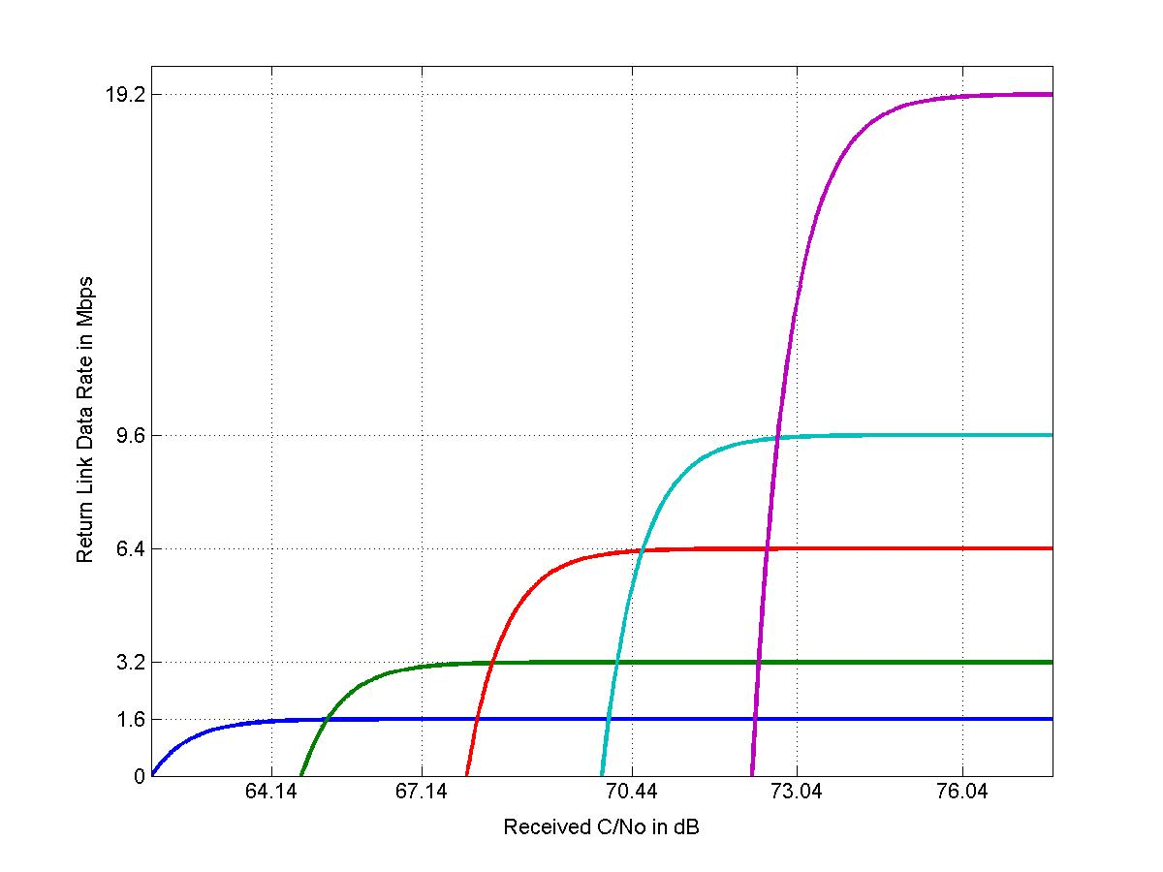
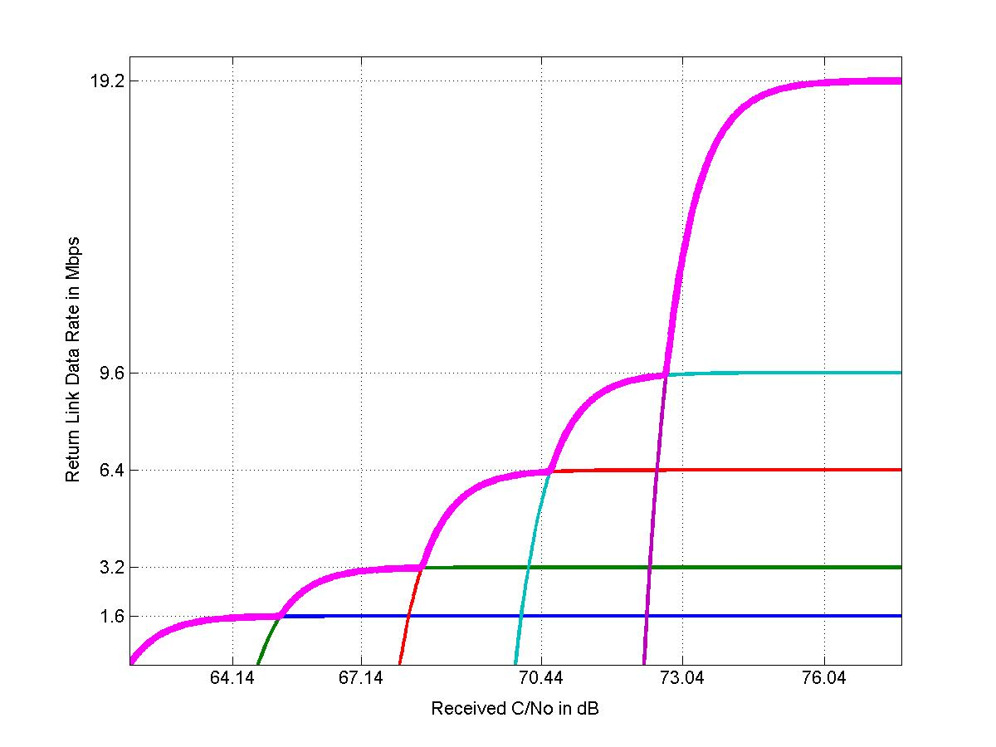
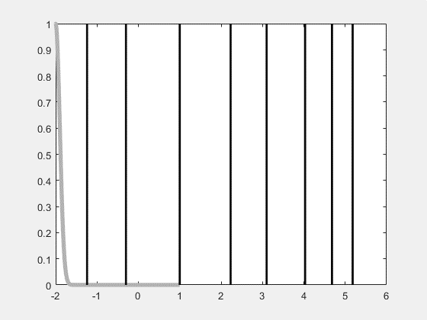
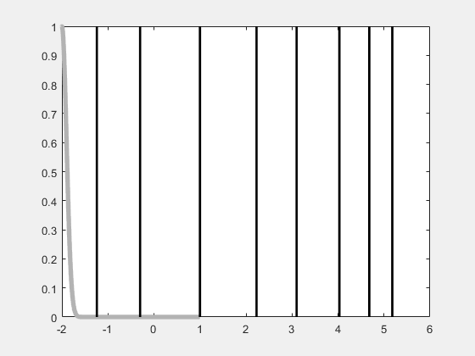
Throughput Adaptation ensures that the achieved throughput is maximized given an operating link condition
1/3
2/5
1/2
3/5
2/3
3/4
5/6
Achieved throughput stays on the envelope of the family of Signal Quality (Es/No) → Throughput curves
4/5
Probability
Achieved Rate
SNR in dB
SNR in dB →

Slide 11
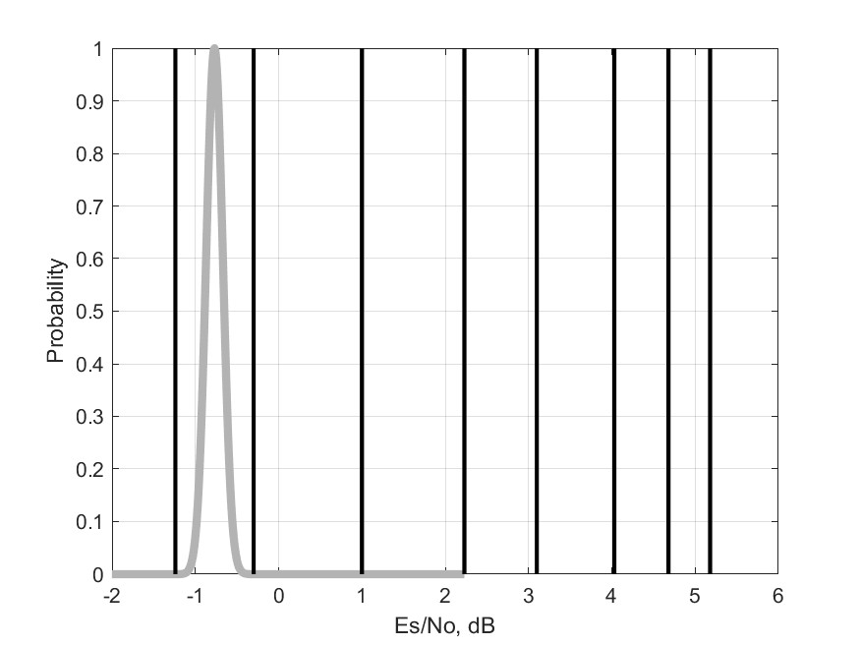
1/3
2/5
1/2
3/5
2/3
3/4
4/5
5/6
Blue: optimal rate achievable
Yellow: achievable rate but suboptimal
Red: rate not achievable
Gray: distribution of SNR in dB; taken to be Gaussian PDF
i.e., the SNR (in the linear scale) is assumed to be log-normally distributed
A realistic model of SNR in the linear scale is that it is the square of a non-central Chi-squared variable. The log-normal distribution is taken as an approximation of this

Slide 12
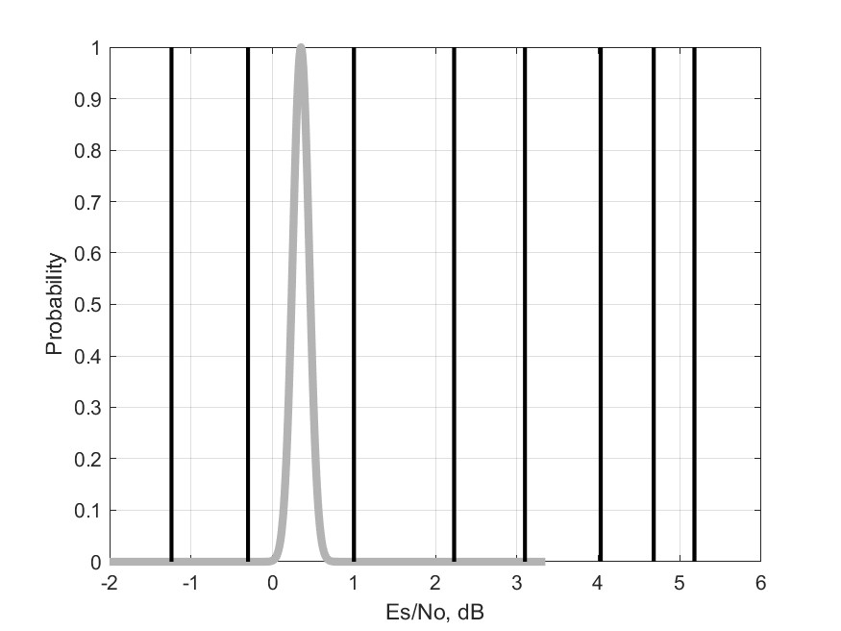
1/3
2/5
1/2
3/5
2/3
3/4
4/5
5/6
Blue: optimal achievable
Yellow: achievable but suboptimal
Red: not achievable

Slide 13
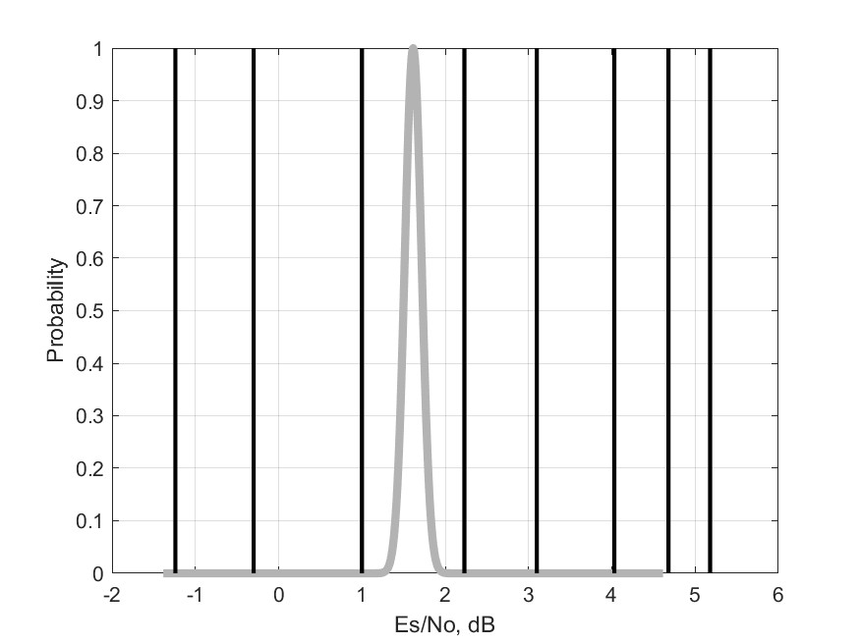
1/3
2/5
1/2
3/5
2/3
3/4
4/5
5/6
Blue: optimal achievable
Yellow: achievable but suboptimal
Red: not achievable

Slide 14
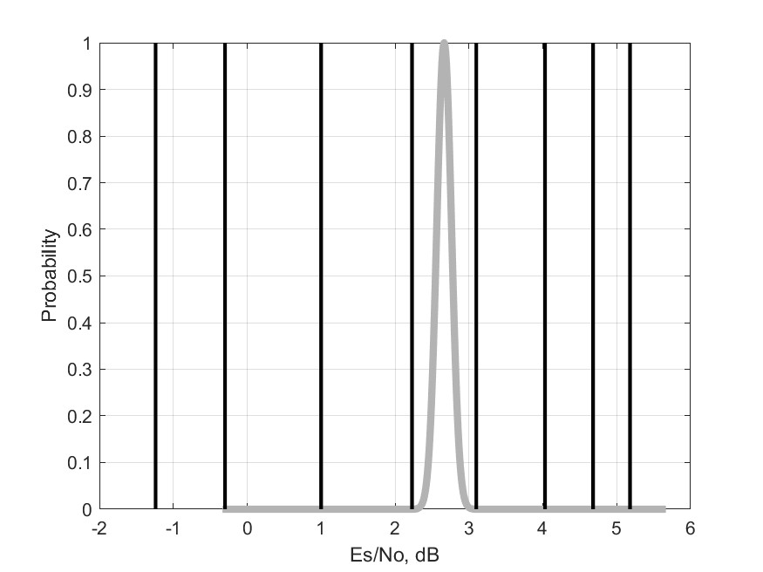
1/3
2/5
1/2
3/5
2/3
3/4
4/5
5/6
Blue: optimal achievable
Yellow: achievable but suboptimal
Red: not achievable

Slide 15
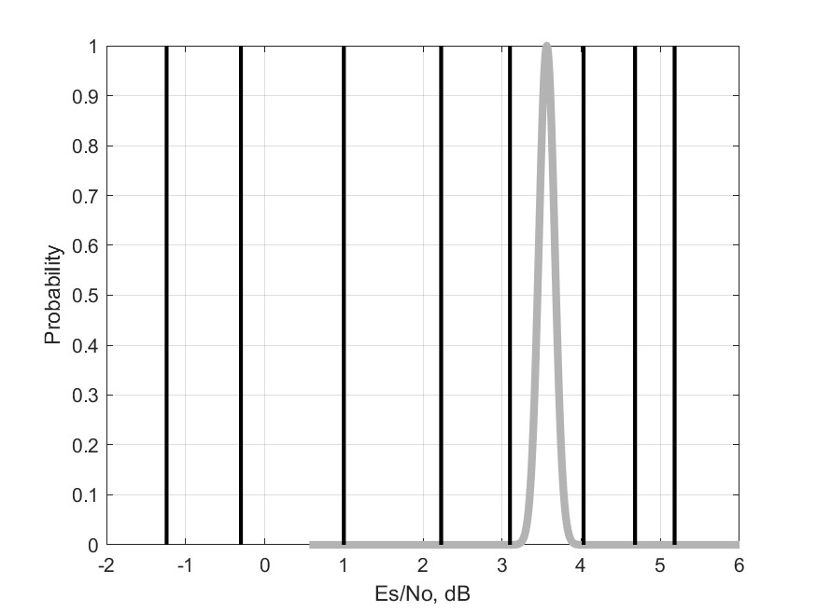
1/3
2/5
1/2
3/5
2/3
3/4
4/5
5/6
Blue: optimal achievable
Yellow: achievable but suboptimal
Red: not achievable

Slide 16
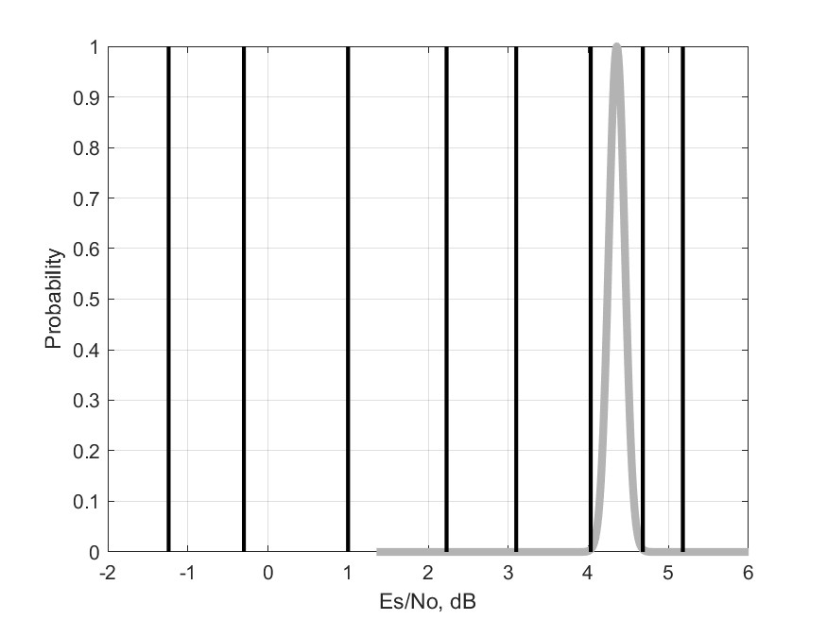
1/3
2/5
1/2
3/5
2/3
3/4
4/5
5/6
Blue: optimal achievable
Yellow: achievable but suboptimal
Red: not achievable

Slide 17
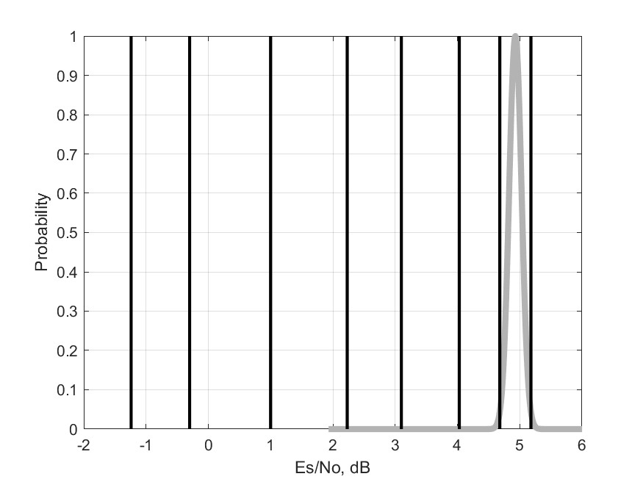
1/3
2/5
1/2
3/5
2/3
3/4
4/5
5/6
Blue: optimal achievable
Yellow: achievable but suboptimal
Red: not achievable

Slide 18
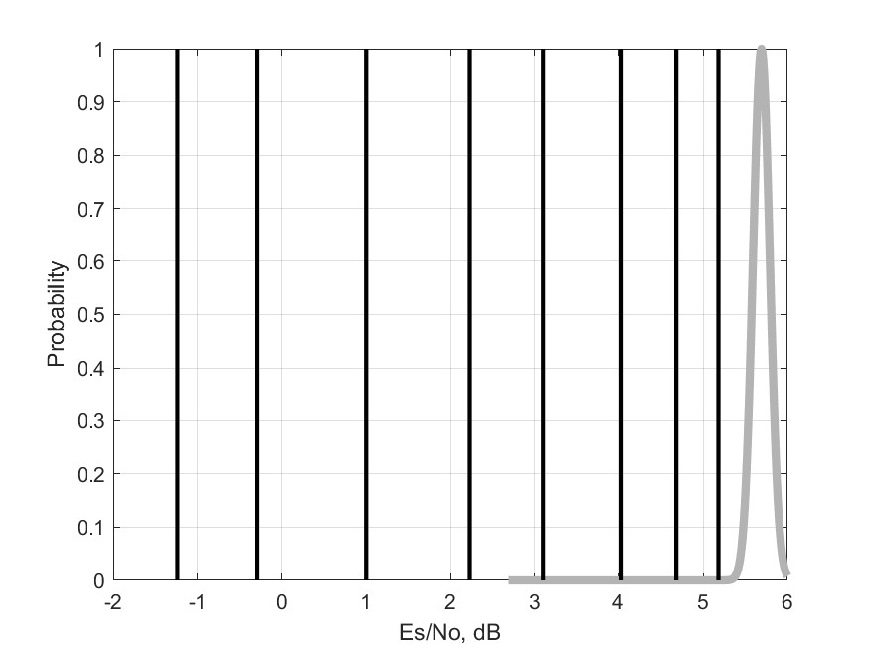
1/3
2/5
1/2
3/5
2/3
3/4
4/5
5/6
Blue: optimal achievable
Yellow: achievable but suboptimal
Red: not achievable

Slide 19
Advantage of Analog Communication Systems over Digital Communication Systems
Discrete-valued voltages are difficult to transmit long distances
Analog-valued electromagnetic waves – in contrast – can be transmitted, using antennas, over large distances
Most of the digital communication systems rely on analog front-end; only the back-end is digital
The front-end analog portion of the communication system is sometimes called a “radio”
The back-end digital processing modules/functions are called “baseband processors/algorithms”
This is seen by drawing a more detailed block diagram of analog and the digital communication systems

Slide 20

A More Detailed Block Diagram of an Analog Communication Modem
Analog-Domain
Digital-Domain
Analog-Domain
$$\sim$$

Slide 21
A More Detailed Block Diagram of a Digital Communication Modem
Analog-Domain
Digital-Domain
Analog-Domain
$$\sim$$

Slide 22
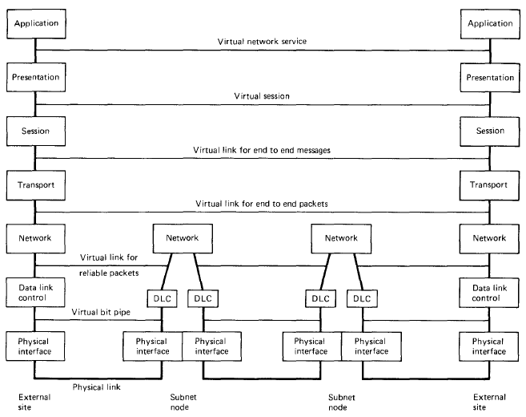
Seven Layer Open System Interconnect (OSI) Model of a Digital Communication System

Slide 23
Next several slides demonstrate one primary function of the DLC and the Network Layers – ensuring that the data packets are received correctly.
Taken from the book “Data Networks”, 2nd Edition, by Bertsekas and Gallagher

Slide 24
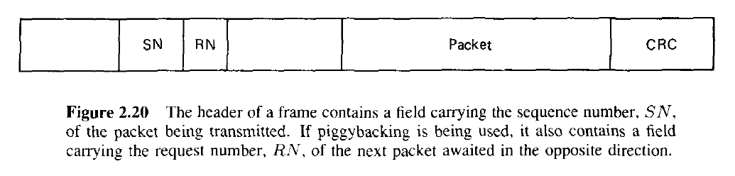
Model of Data Packets
SN: Sequence Number; RN: Request Number;
CRC: Cyclic Redundancy Check (provides error detection but not correction)

Slide 25
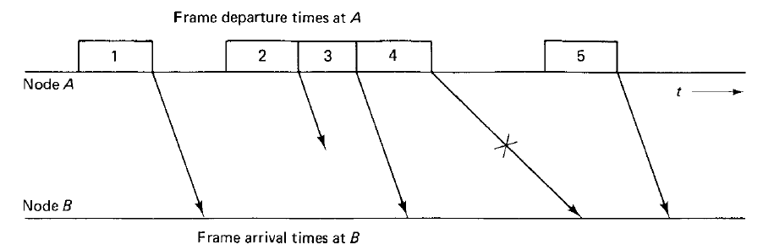

Slide 26
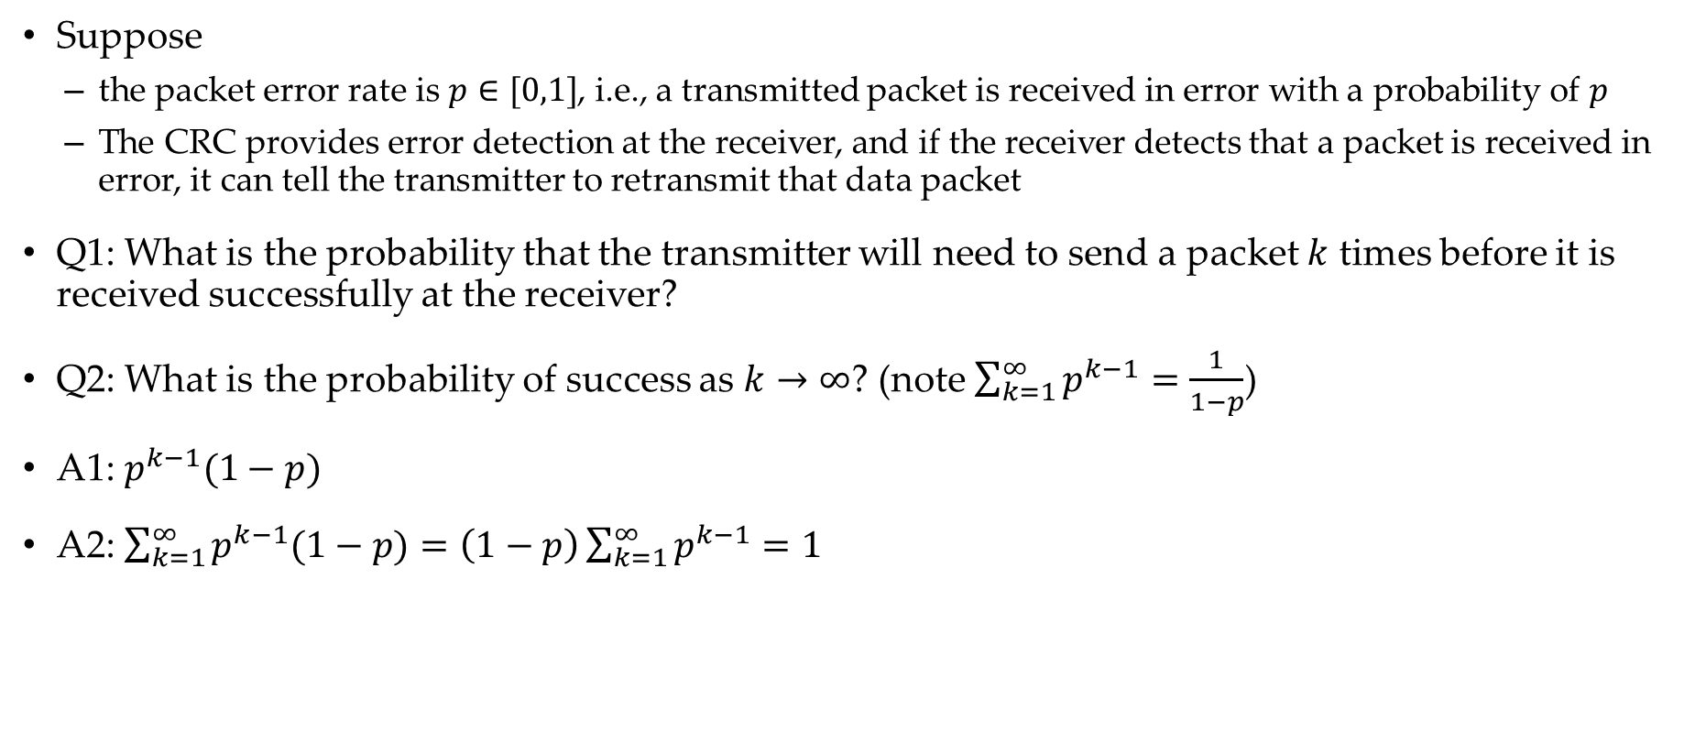
Two Questions
Suppose
the packet error rate is $p∈[0,1]$, i.e., a transmitted packet is received in error with a probability of $p$
The CRC provides error detection at the receiver, and if the receiver detects that a packet is received in error, it can tell the transmitter to retransmit that data packet
Q1: What is the probability that the transmitter will need to send a packet $k$ times before it is received successfully at the receiver?
Q2: What is the probability of success as $k→∞$? (note $\sum_{k=1}^{∞}{p^{k−1}}=\frac{1}{1−p}$)
A1: $p^{k−1}(1−p)$
A2: $\sum_{k=1}^{∞}{p^{k−1}(1−p)}=\left(1−p\right)\sum_{k=1}^{∞}{p^{k−1}}=1$

Slide 27
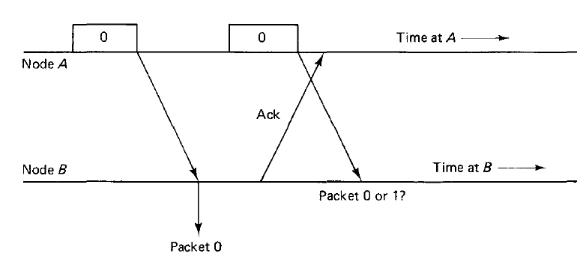
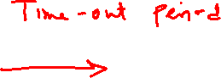

Slide 28
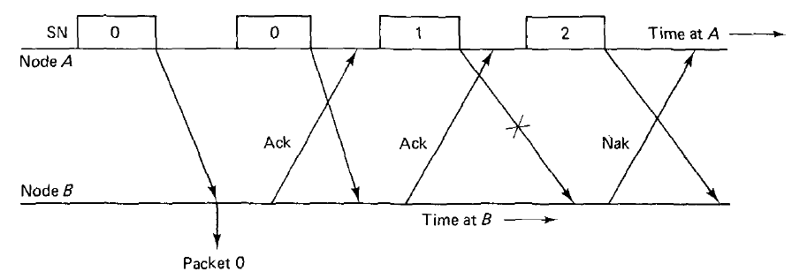
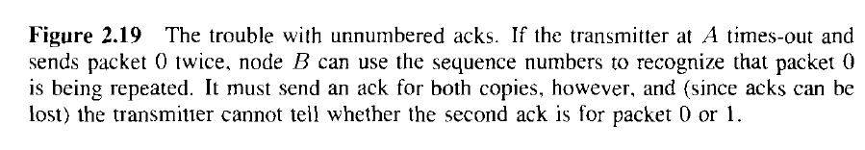

Slide 29
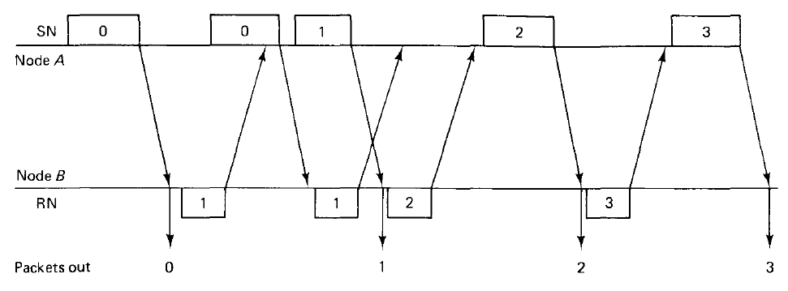
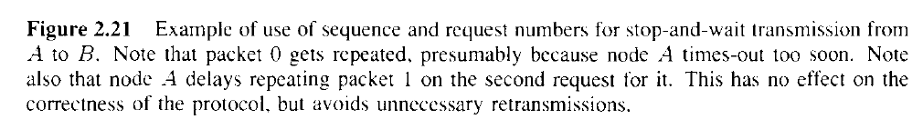
This is called Stop And Wait (SAW) Automatic Repeat Request (ARQ)

Slide 30

A More Efficient Protocol, called Go Back $n$ Scheme

Slide 32
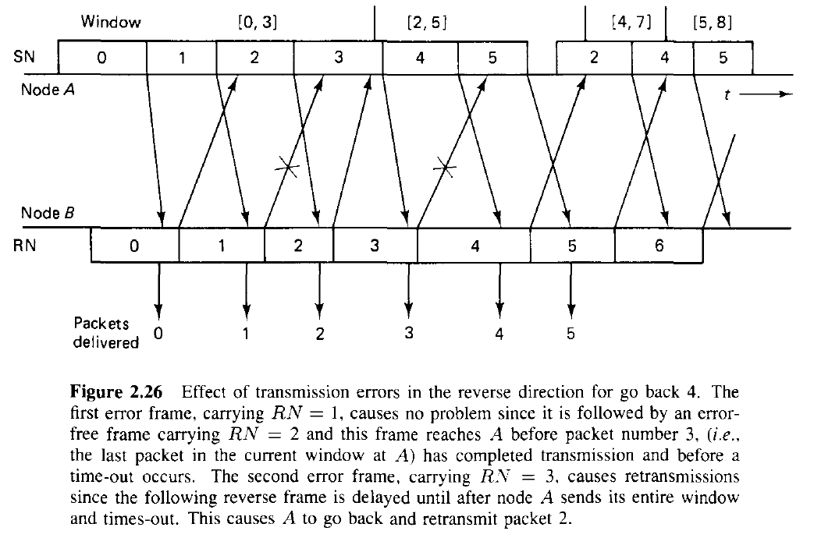

Slide 33
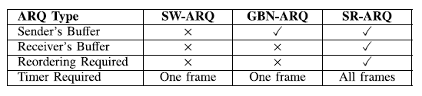
ARQ Categories
Complexity
ARQ
SR
GBN
Stop and Wait (SW)
Sliding Window
SW
Go Back N (GBN)
Selective Repeat (SR)
Efficiency

Slide 34
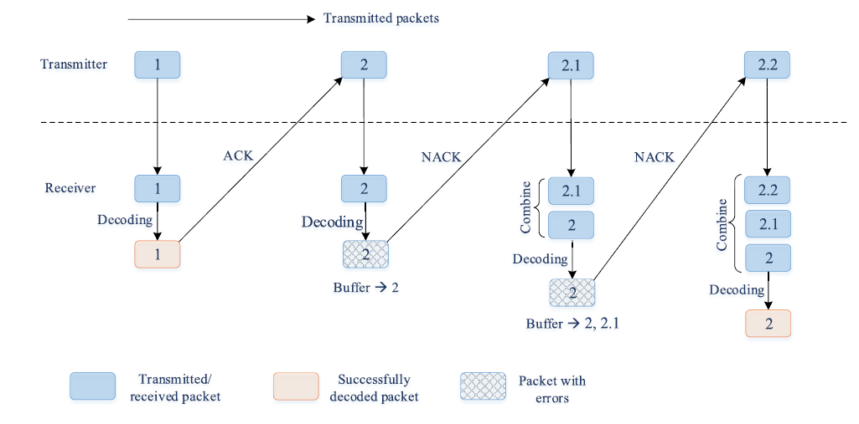
An Illustration of Hybrid ARQ

Slide 35
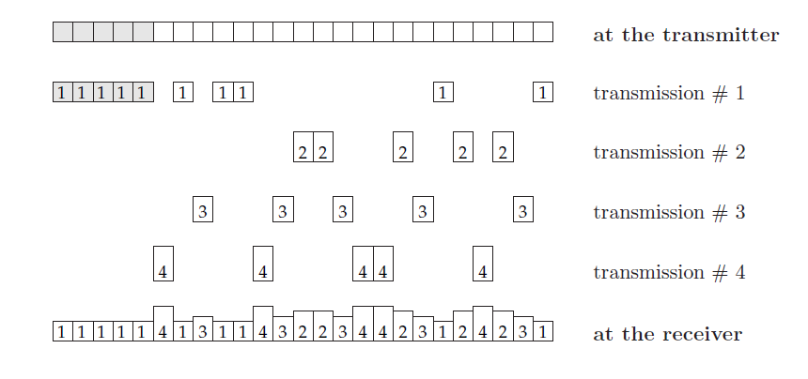
An Illustration of HARQ IR
From [3]
Incremental Redundancy Type II HARQ (Gray: Systematic Bits, White: Parity Bits)

Slide 36
The course “Data Networks” provides a detailed study of this and related concepts of the upper layers of the OSI model
In CT216, our focus is primarily on the PHY (the physical) layer

Slide 37
Frequency Upconversion and Downconversion
A widely popular scheme for transmission of communication messages uses sinusoidal carrier waveforms
Carrier is to be thought of as a truck or goods train.
Message symbols are analogous to the actual items that are being transported
Reasons for the choice of sinusoidal waveforms:
Electromagnetic signals are sinusoidal, and they propagate well in the atmosphere and over the cables
Choice of carrier frequency allows placement of transmitted signal at the desired portion of the spectrum
Choice of carrier frequency can be traded off with antenna size and the path loss that the signal experiences

Slide 38
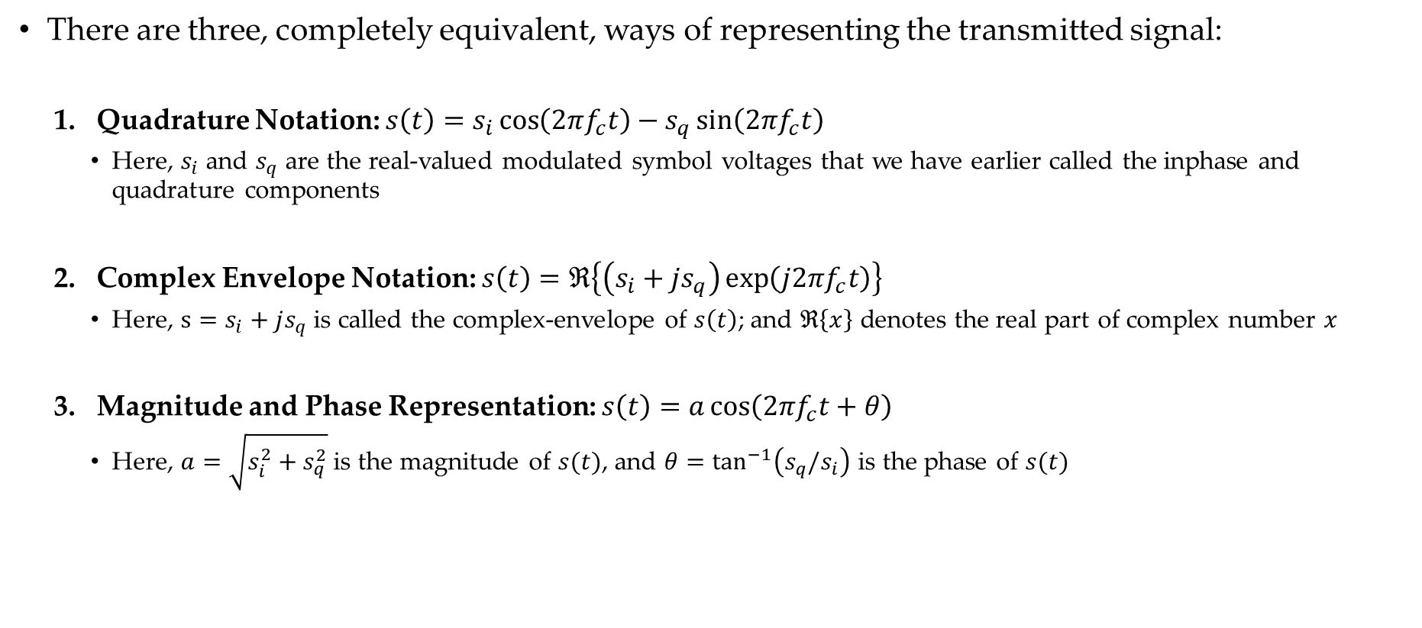
Representation of the Frequency Up/Down Conversion
There are three, completely equivalent, ways of representing the transmitted signal:
Quadrature Notation: $s\left(t\right)=s_{i}\cos\left(2πf_{c}t\right)−s_{q}\sin\left(2πf_{c}t\right)$
Here, $s_{i}$ and $s_{q}$ are the real-valued modulated symbol voltages that we have earlier called the inphase and quadrature components
Complex Envelope Notation: $s\left(t\right)=ℜ\left\{\left(s_{i}+js_{q}\right)\exp\left(j2πf_{c}t\right)\right\}$
Here, $s=s_{i}+js_{q}$ is called the complex-envelope of $s\left(t\right)$; and $ℜ\left\{x\right\}$ denotes the real part of complex number $x$
Magnitude and Phase Representation: $s\left(t\right)=a\cos\left(2πf_{c}t+θ\right)$
Here, $a=\sqrt{s_{i}^{2}+s_{q}^{2}}$ is the magnitude of $s(t)$, and $θ=\tan^{−1}\left(s_{q}/s_{i}\right)$ is the phase of $s(t)$

Slide 39
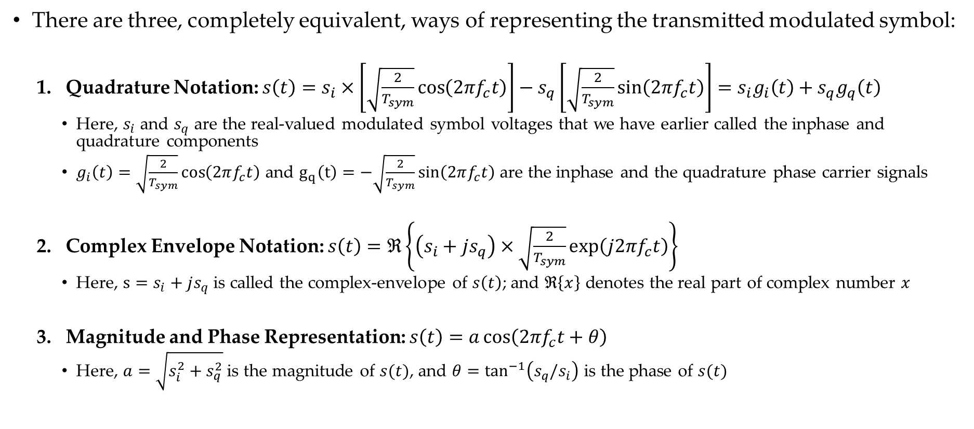
Representation of the Frequency Up/Down Conversion
There are three, completely equivalent, ways of representing the transmitted modulated symbol:
Quadrature Notation: $s\left(t\right)=s_{i}×\left[\sqrt{\frac{2}{T_{sym}}}\cos\left(2πf_{c}t\right)\right]−s_{q}\left[\sqrt{\frac{2}{T_{sym}}}\sin\left(2πf_{c}t\right)\right]=s_{i}g_{i}\left(t\right)+s_{q}g_{q}\left(t\right)$
Here, $s_{i}$ and $s_{q}$ are the real-valued modulated symbol voltages that we have earlier called the inphase and quadrature components
$g_{i}\left(t\right)=\sqrt{\frac{2}{T_{sym}}}\cos\left(2πf_{c}t\right)$ and $g_{q}\left(t\right)=−\sqrt{\frac{2}{T_{sym}}}\sin\left(2πf_{c}t\right)$ are the inphase and the quadrature phase carrier signals
Complex Envelope Notation: $s\left(t\right)=ℜ\left\{\left(s_{i}+js_{q}\right)×\sqrt{\frac{2}{T_{sym}}}\exp\left(j2πf_{c}t\right)\right\}$
Here, $s=s_{i}+js_{q}$ is called the complex-envelope of $s\left(t\right)$; and $ℜ\left\{x\right\}$ denotes the real part of complex number $x$
Magnitude and Phase Representation: $s\left(t\right)=a\cos\left(2πf_{c}t+θ\right)$
Here, $a=\sqrt{s_{i}^{2}+s_{q}^{2}}$ is the magnitude of $s(t)$, and $θ=\tan^{−1}\left(s_{q}/s_{i}\right)$ is the phase of $s(t)$

Slide 40
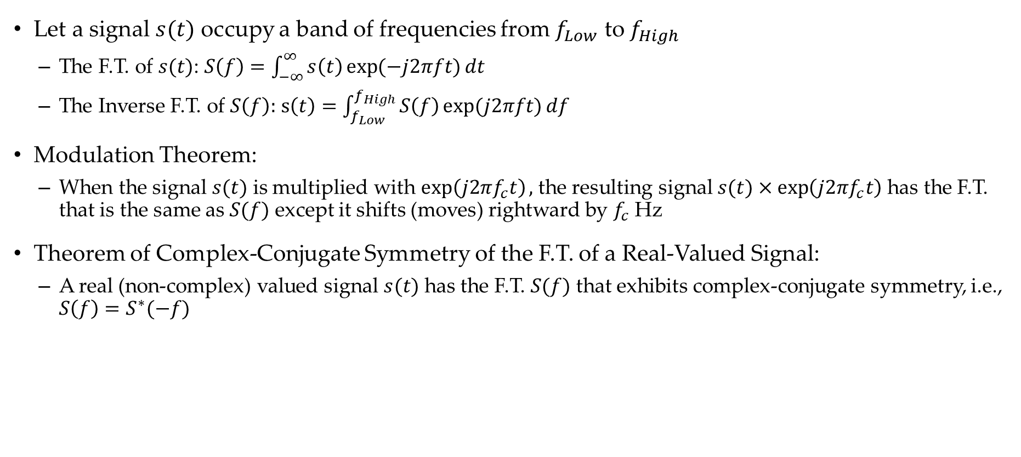
The Fourier Transform (F.T.) and Two Theorems
Let a signal $s(t)$ occupy a band of frequencies from $f_{Low}$ to $f_{High}$
The F.T. of $s(t)$: $S\left(f\right)=\int_{−∞}^{∞}{s\left(t\right)\exp{(−j2πft)}dt}$
The Inverse F.T. of $S\left(f\right):$ $s\left(t\right)=\int_{f_{Low}}^{f_{High}}{S\left(f\right)\exp{(j2πft)}df}$
Modulation Theorem:
When the signal $s(t)$ is multiplied with $\exp\left(j2πf_{c}t\right),$ the resulting signal $s(t)×\exp\left(j2πf_{c}t\right)$ has the F.T. that is the same as $S(f)$ except it shifts (moves) rightward by $f_{c}$ Hz
Theorem of Complex-Conjugate Symmetry of the F.T. of a Real-Valued Signal:
A real (non-complex) valued signal $s(t)$ has the F.T. $S(f)$ that exhibits complex-conjugate symmetry, i.e., $S\left(f\right)=S^{∗}(−f)$

Slide 41
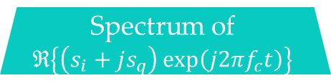
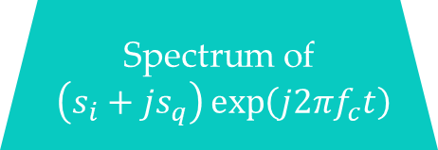
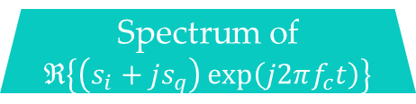
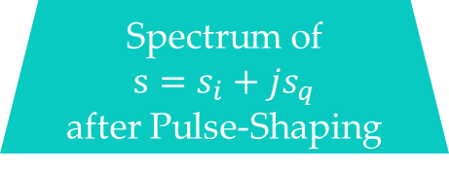
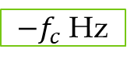
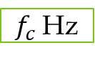
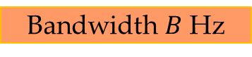
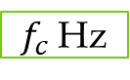
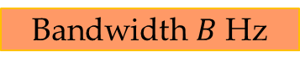
Frequency Upconversion
Spectrum of
$s=s_{i}+js_{q}$
after Pulse-Shaping
0 Hz
Bandwidth $B$ Hz
Due to the modulation theorem of the F. T.
Spectrum of
$\left(s_{i}+js_{q}\right)\exp\left(j2πf_{c}t\right)$
0 Hz
$f_{c}$ Hz
A real-valued time-domain signal has conjugate symmetric spectrum
Bandwidth $B$ Hz
Spectrum of
$$ℜ\left\{\left(s_{i}+js_{q}\right)\exp\left(j2πf_{c}t\right)\right\}$$
Spectrum of
$ℜ\left\{\left(s_{i}+js_{q}\right)\exp\left(j2πf_{c}t\right)\right\}$
${−f}_{c}$ Hz
0 Hz
$f_{c}$ Hz

Slide 42
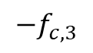
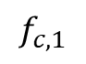
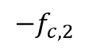
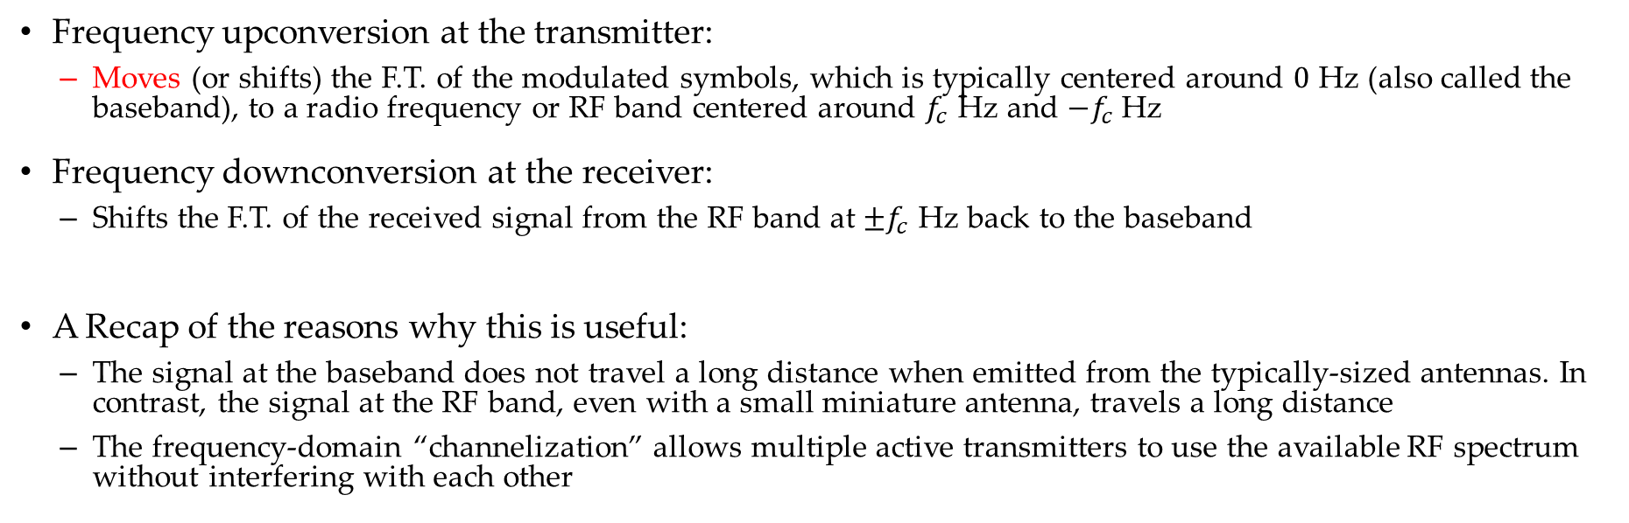
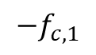
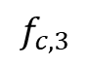
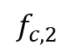
Representation of the Frequency Up/Down Conversion
Frequency upconversion at the transmitter:
Moves (or shifts) the F.T. of the modulated symbols, which is typically centered around $0$ Hz (also called the baseband), to a radio frequency or RF band centered around $f_{c}$ Hz and $−f_{c}$ Hz
Frequency downconversion at the receiver:
Shifts the F.T. of the received signal from the RF band at $±f_{c}$ Hz back to the baseband
A Recap of the reasons why this is useful:
The signal at the baseband does not travel a long distance when emitted from the typically-sized antennas. In contrast, the signal at the RF band, even with a small miniature antenna, travels a long distance
The frequency-domain “channelization” allows multiple active transmitters to use the available RF spectrum without interfering with each other
Tx 3
Tx 3
Transmitter 1
Transmitter 2
Transmitter 2
Transmitter 1
$$−f_{c,1}$$
$${−f}_{c,2}$$
$${−f}_{c,3}$$
0
$$f_{c,1}$$
$$f_{c,2}$$
$$f_{c,3}$$

Slide 45

Representation of the Frequency Up/Down Conversion: A Linear Algebra View
Consider a matrix $G_{Mod}$ whose two columns are vectors $g_{1}$ and $g_{2}$; i.e., $G_{Mod}=\left[\begin{matrix}g_{1} & g_{2}\end{matrix}\right]$
Let $G_{Mod}$ be an orthogonal matrix, i.e.,
Each of its two column vectors is unit length: $g_{1}^{T}g_{1}=g_{2}^{T}g_{2}=1$
The two column vectors are perpendicular to each other: $g_{1}^{T}g_{2}=g_{2}^{T}g_{1}=0$
What is the matrix product $G_{Mod}^{T}G_{Mod}$?
$G_{Mod}^{T}G_{Mod}=\left[\begin{matrix}g_{1}^{T} \\ g_{2}^{T}\end{matrix}\right]\left[\begin{matrix}g_{1} & g_{2}\end{matrix}\right]=\left[\begin{matrix}g_{1}^{T}g_{1} & g_{1}^{T}g_{2} \\ g_{2}^{T}g_{1} & g_{2}^{T}g_{2}\end{matrix}\right]=\left[\begin{matrix}1 & 0 \\ 0 & 1\end{matrix}\right]=I_{2}$

Slide 46

Representation of the Frequency Up/Down Conversion: A Linear Algebra View
The simplified model of modulator:
chooses one (let’s say, m-th) symbol of $M=2^{k}$ symbols from a constellation map
The coordinates of this constellation point are specified by a $2×1$ vector $s_{m}=\left[\begin{matrix}s_{m,1} \\ s_{m,2}\end{matrix}\right]$
The model of frequency up-converter at the transmitter:
Converts the modulation symbol vector $s_{m}$ at the baseband to an RF signal as $G_{Mod}s_{m}$
This can be written as linear superposition of the columns of $G_{Mod}$, i.e., as $g_{1}s_{m,1}+g_{2}s_{m,2}$
The model of frequency down-converter at the receiver (in the absence of noise):
The received signal is the vector $r=G_{Mod}s_{m}$
The downconveter multiplies $G_{Mod}^{T}$ and $r$ to obtain
$G_{Mod}^{T}r=G_{Mod}^{T}G_{Mod}s_{m}=s_{m}$
This can be written as inner product operations $\left[\begin{matrix}g_{1}^{T}r \\ g_{2}^{T}r\end{matrix}\right]$
This concept is elaborated upon next by (i) drawing block diagram representations, (ii) generalizing the number of modulation dimensions from $2$ to $K$, and (iii) introducing the time variable $t$

Slide 55








A Block Diagram of the Frequency Upconverter
Two equivalent viewpoints:
Linear superposition of column vectors
Synthesis of the signal $s\left(t\right)$ from the vector $s_{m}$
$$G_{Mod}(t)$$
$$g_{1}(t)$$
$$g_{2}(t)$$
$$s\left(t\right)=G_{Mod}\left(t\right)s_{m}$$
$$g_{K}(t)$$
$$s\left(t\right)=G_{Mod}\left(t\right)s_{m}$$

Slide 56








Representation of the Noise Introduced by the Channel at the Radio Frequency Spectral Band
$$G_{Mod}(t)$$
$$g_{1}(t)$$
$$g_{2}(t)$$
$$n\left(t\right)=G_{mod}\left(t\right)n$$
$u(t)$: the portion of the noise added by the channel that resides in dimensions other than those spanned by $g_{1}\left(t\right),…,g_{K}(t)$
$$g_{K}(t)$$
$$n\left(t\right)=G_{Mod}\left(t\right)n$$

Slide 57













The Received Signal at the Output of the RF Channel
Block diagram representation of the received signal
$$r\left(t\right)=G_{Mod}\left(t\right)s_{m}+G_{Mod}\left(t\right)n+u(t)$$
$$g_{1}(t)$$
$$g_{K−1}(t)$$
$$g_{K}(t)$$
$$G_{Mod}(t)$$
$$G_{Mod}(t)$$
$$g_{1}(t)$$
$$n\left(t\right)=G_{Mod}\left(t\right)n$$
$$s\left(t\right)=G_{Mod}\left(t\right)s_{m}$$
$$g_{2}(t)$$
$$r\left(t\right)$$
$$g_{K}(t)$$

Slide 58







A Block Diagram of the Receiver Downconversion
Block diagram representation of
$$r=G_{Mod}^{T}\left(t\right)r(t)$$
Two equivalent viewpoints:
Projection of $r\left(t\right)$ onto the row vectors of $G_{Mod}^{T}\left(t\right)$
i.e., columns of $G_{Mod}^{}(t)$
Analysis of the received signal $r(t)$
$$g_{1}(t)$$
$$g_{2}(t)$$
$$g_{K}(t)$$
$$G_{Mod}^{T}(t)$$

Slide 59











Synthesis and Analysis Viewpoints of the Frequency Upconverstion and Downconversion
In the absence of noise, $r_{k}=s_{m,k}$
$$G_{Mod}(t)$$
$$g_{1}(t)$$
$$g_{1}(t)$$
$$g_{2}(t)$$
$$g_{2}(t)$$
$$s\left(t\right)=G_{Mod}\left(t\right)s_{m}$$
$$g_{K}(t)$$
$$g_{K}(t)$$
$$s\left(t\right)=G_{Mod}\left(t\right)s_{m}$$
$$G_{Mod}^{T}(t)$$

Slide 60
















Model of Frequency Upconversion and Downconversion
A claim: the noise signal $u(t)$ has no effect on the receiver. Why?
$$g_{1}(t)$$
$$g_{1}(t)$$
$$g_{K−1}(t)$$
$$g_{K}(t)$$
$$G_{Mod}(t)$$
$$G_{Mod}(t)$$
$$g_{2}(t)$$
$$g_{1}(t)$$
$$n\left(t\right)=G_{Mod}\left(t\right)n$$
$$s\left(t\right)=G_{Mod}\left(t\right)s_{m}$$
$$g_{2}(t)$$
$$r\left(t\right)$$
$$g_{K}(t)$$
$$g_{K}(t)$$
$$G_{Mod}^{T}(t)$$

Slide 61
Model of Frequency Upconversion and Downconversion: Equivalence with the Simplified Model of the Modulation
$$g_{1}(t)$$
$$g_{1}(t)$$
$$g_{K−1}(t)$$
$$g_{K}(t)$$
$$G_{Mod}(t)$$
$$G_{Mod}(t)$$
$$g_{2}(t)$$
$$g_{1}(t)$$
$$n\left(t\right)=G_{Mod}\left(t\right)n$$
$$s\left(t\right)=G_{Mod}\left(t\right)s_{m}$$
$$g_{2}(t)$$
$$r\left(t\right)$$
$$g_{K}(t)$$
$$g_{K}(t)$$
$$G_{Mod}^{T}(t)$$

Slide 62

Equivalence with the Simplified Model of the Modulation

Slide 63




Frequency Downconversion: A Mathematical Equation
At the receiver, the process of frequency downconversion, in the absence of noise, recovers $\left[s_{i},s_{q}\right]$ from the received signal $s\left(t\right)=s_{i}×\left[\sqrt{\frac{2}{T_{sym}}}\cos\left(2πf_{c}t\right)\right]−s_{q}\left[\sqrt{\frac{2}{T_{sym}}}\sin\left(2πf_{c}t\right)\right]$
The recovery of the inphase component is obtained as follows:
$$\int_{0}^{T_{sym}}{s(t)}\sqrt{\frac{2}{T_{sym}}}\cos\left(2πf_{c}t\right)dt$$
$$=\frac{2}{T_{sym}}\int_{0}^{T_{sym}}{s_{i}}\cos^{2}\left(2πf_{c}t\right)dt−\frac{2}{T_{sym}}\int_{0}^{T_{sym}}{s_{q}}\cos\left(2πf_{c}t\right)\sin\left(2πf_{c}t\right)dt$$
$$=\frac{2}{T_{sym}}×\frac{1}{2}\int_{0}^{T_{sym}}{s_{i}}\left(1−\cos\left(4πf_{c}t\right)\right)dt−\frac{2}{T_{sym}}×\frac{1}{2}\int_{0}^{T_{sym}}{s_{q}}\sin\left(4πf_{c}t\right)dt$$
$$=\frac{s_{i}}{T_{sym}}\int_{0}^{T_{sym}}{}dt−\frac{s_{i}}{T_{sym}}\int_{0}^{T_{sym}}{\cos\left(4πf_{c}t\right)}dt−\frac{s_{q}}{T_{sym}}\int_{0}^{T_{sym}}{\sin\left(4πf_{c}t\right)}dt$$
$$=s_{i}$$
(since $\frac{1}{T_{sym}}\int_{0}^{T_{sym}}{\sin\left(4πf_{c}t\right)dt }=\frac{1}{T_{sym}}\int_{0}^{T_{sym}}{\cos\left(4πf_{c}t\right)dt }≈0$)

Slide 64




Frequency Downconversion: A Mathematical Equation
At the receiver, the process of frequency downconversion, in the absence of noise, recovers $\left[s_{i},s_{q}\right]$ from the received signal $s\left(t\right)=s_{i}g_{i}\left(t\right)+s_{q}g_{q}(t)$
The recovery of the inphase component is obtained as follows:
The recovery of the quadrature component $s_{q}$ can be derived in an analogous manner
$$=\int_{0}^{T_{sym}}{s_{i}}g_{i}^{2}\left(t\right)dt+\int_{0}^{T_{sym}}{s_{q}}g_{i}\left(t\right)g_{q}\left(t\right)dt$$
$$\int_{0}^{T_{sym}}{s\left(t\right)}g_{i}(t)dt$$
$$=s_{i}$$
(since $\int_{0}^{T_{sym}}{g_{i}^{2}(t)dt }=1;and \int_{0}^{T_{sym}}{g_{i}\left(t\right)g_{q}\left(t\right)dt =}0$)

Slide 65

Estimation of Demodulation Parameters at the Receiver
The derivation on the prior slide shows that the receiver has to generate $\cos\left(2πf_{c}t\right)$ and $\sin\left(2πf_{c}t\right)$ waveforms that are both frequency and phase aligned with the frequency and the phase at the transmitter
The receiver should generate the sinusoidal signals at the correct frequency $f_{c}$ and with zero phase
Homework:
Analyze how the receiver performance degrades if the downconversion uses $\cos\left(2πf_{c}t+φ\right)$ and $\sin\left(2πf_{c}t+φ\right),$ where $φ$ is an unknown phase offset at the receiver relative to the transmitter

Slide 66












A Simple Model of Digital Communication System for the BPSK or OOK Modulation Schemes
A simple digital modulation scheme:
Transmitted modulated symbol
Noisy received symbol
Bits to Symbol Mapping (BPSK)
$X=1→s=+a$ volts
$X=0→s=−a$ volts
Demodulator (BPSK)
$$r≥0→\hat{X}=1$$
$$r<0→\hat{X}=0$$
$$X$$
$$s$$
$$r=s+n$$
$$\hat{X}$$
Bits $X ∈\{0,1\}$ at the input to the modulator
$$n$$
Bits $\hat{X}$ $∈\{0,1\}$ at the output of the demodulator
Additive Noise Channel
A common type: Gaussian distributed zero-mean noise with variance $σ_{n}^{2}$
Bits to Symbol Mapping (OOK)
$X=1→s=+a$ volts
$X=0→s= 0$ volts
Demodulator (OOK)
$$r≥\frac{a}{2}→\hat{X}=1$$
$$r<\frac{a}{2}→\hat{X}=0$$

Slide 70

A Simple Model of Digital Communication System for the BPSK or OOK Modulation Schemes
For the BPSK transmitter, determine the odds in favor of $X=1$ when a particular received voltage $r$ is observed at the output of the Gaussian noise channel
For what values of $r$ does the Bayesian receiver decide that $X=1$ is transmitted?
How does the Bayesian receiver compare against the minimum-distance decoder which measures the distances between $r$ and the transmitted symbols and selects that symbol for which this distance is minimal?

Slide 71


Slide 72


Slide 73


Slide 74


Slide 75



Slide 76


$$−4ra$$

Slide 77

Probability of (Demodulated) Bit Error
Typically the analytical expression of the performance of a Bayesian receiver in the presence of noise is difficult to derive
However, for the BPSK receiver, this is possible, and it is derived by integrating the conditional PDF of $r$ given a transmitted symbol for one half of the decision region
This essentially gives the probability that $r$ falls on the wrong side of the decision boundary

Slide 78





Probability of (Demodulated) Bit Error
Since the decision boundary is $r=0,$ the probability of demodulation error is given as
$P\left(e=1\right)=P\left(X=1,e=1\right)+P\left(X=0,e=1\right)$ Marginalization of the joint PDF
$=P\left(X=1\right)P\left(e=1 | X=1\right)+P\left(X=0\right)P\left(e=1 | X=0\right)$ Alternate expression of the joint PDF
$=0.5×(P\left(e=1 | X=1\right)+P\left(e=1 | X=0\right))$ since $P\left(X=0\right)=P\left(X=1\right)=0.5$
$=0.5×(P\left(r<0 | X=1\right)+P\left(r>0 | X=0\right))$ Given the Bayesian decision rule
$$P(r>0|X=0)$$
Now,
Similarly, it can be shown that $P\left(r<0 | X=1\right)=Q\left(\frac{a}{σ_{n}}\right)$.
Therefore, the probability of demodulated bit error $P\left(e=1\right)=Q\left(\frac{a}{σ_{n}}\right)$

Slide 82





Benefits of the Simplified Model
Shows (for the BPSK) how the bits are mapped to the voltage levels that are transmitted
Shows that the transmitted symbol are mapped on a line, also provides a formulation of the transmitted symbol energy $E_{s}$ (which is equal to the bit energy $E_{b}$ for the BPSK and OOK)
Known as the constellation diagram of the modulation scheme
Modeling of a realistic Gaussian-distributed impairment introduced by practical communication channel
Provides a model of the received symbols on a line, which conceptualizes the EVM at the receiver
A definition: the square of the distance of the transmitted symbol from the origin is called the energy per symbol $E_{s}$
Different symbols can, in general, have different values of $E_{s}$. However, for BPSK, $E_{s}=a^{2}$ for all the transmitted symbols
A definition: Error vector magnitude or EVM is the length of the distance between the red dot (the received signal) and the blue dot (the transmitted signal). The EVM is generally averaged over all the received symbols and it indicates the power of the noise $σ_{n}^{2}$
Transmitted
Received

Slide 83



Benefits of the Simplified Model
Shows how to formulate and derive the optimal (Bayesian) BPSK or OOK demodulator
The mathematical Bayesian formulation of the receiver is based on this simplified model
Shows that the optimal BPSK demodulator has a decision boundary at $r=0$
The decision regions are $r≥0→\hat{X}=1; r<0→\hat{X}=0$
Allows a clear visualization of the minimum-distance receiver, which is identical to the Bayesian receiver in the Gaussian noise
Decision boundary at $r=0$

Slide 84




Benefits of the Simplified Model
Allows the theoretical evaluation of the performance of the communication system in the Gaussian noise channel
As derived earlier, the probability of bit error has a theoretical expression given as $P_{b}^{err}=Q\left(\frac{a}{σ_{n}}\right)$
The theoretical expression can be compared against the simulation or the Laboratory hardware results
We have developed in an earlier Lab a BPSK simulator with the block diagram on the previous slide; the results of the simulation match with the above theoretical expression
The theoretical expression shows that the system performance depends only on the ratio $\frac{a}{σ_{n}}$
The absolute values of $a$ and $σ_{n}$ do not matter; only the ratio does
Furthermore, this ratio for the BPSK or OOK is often expressed as $\sqrt{{2E}_{b}/N_{0}}$, where $E_{b}=a^{2}$ is the energy per bit and $N_{0}$ is the power spectral density of the White Gaussian noise which is given as $N_{0}=2σ_{n}^{2}$
$\frac{E_{b}}{N_{0}}=\frac{a^{2}}{2σ_{n}^{2}}$ in dB

Slide 85



















Benefits of the Simplified Model: Two Conceptual Insights
The decision boundary (shown in red) is halfway between the constellation points. Why?
Besides $σ_{n}$, the theoretical probability of error depends only on the distance $d$ between the constellation points, not their exact amplitudes. Why?
Specifically, $P_{b}^{err}=Q\left(\frac{d}{2σ_{n}}\right)=Q\left(\frac{d}{\sqrt{2N_{0}}}\right);$ $d=2a$ for BPSK, $d=a$ for OOK
Scheme 1: $P_{b}^{err}=Q\left(\frac{2.5}{σ_{n}}\right)$
Scheme 1
Scheme 2: $P_{b}^{err}=Q\left(\frac{1}{σ_{n}}\right)$
Scheme 2
Scheme 3: $P_{b}^{err}=Q\left(\frac{1}{σ_{n}}\right)$
Transmitted voltage for $X=1$
Scheme 3
Transmitted voltage for $X=0$
Transmitted voltage $s$
$$−4$$
$$−3$$
$$−2$$
$$−1$$
$$0$$
$$1$$
$$2$$
$$3$$
$$4$$
$$5$$
$$6$$
$$7$$

Slide 89


A Brief Remark on the Power Spectral Density and the White Noise
The noise affecting the communication link is often modeled as spectrally white
Analogous to the spectrum of the white light, the noise is typically observed to have all the frequency components that are statistically equally powered (i.e., power spectral density or PSD equals a constant $N_{0}$)
We will not be studying the concept of the PSD in detail in this class; a very high level idea of the PSD is that it is proportional to the square of the magnitude of the Fourier Transform (averaging may be required)
Power Spectral Density $N_{0}$ of the white noise

Slide 90

Benefits of the Simplified Model: Generalization to More Complex Modulation Schemes
The constellation diagram for BPSK shows that it is a one-dimensional (1D) modulation
1D because the two possible transmitted symbols are located on a line passing through the origin
However, the diagram indicates a generalization to 2D modulation.
This is indeed possible as shown below for a modulation scheme known as quadrature phase shift keying or QPSK
X-axis of this diagram corresponds to the inphase signal, which is just the BPSK signal
However, there is another BPSK signal on the Y-axis. This is called the quadrature signal
The QPSK is essentially two BPSK signals transmitted together; one on the inphase and another on the quadrature

Slide 91









QPSK Modulation Scheme
The QPSK modulation scheme has four symbols (twice of the BPSK symbols). They are arranged on a 2D plane – many arrangements are possible, one is shown on the prior slide, another is shown here
Just as the BPSK transmitter sends one of two symbols at a time using one bit, the QPSK transmitter sends one of the four symbols at a given time using two bits (QPSK symbol carries two bits; BPSK symbol carries one bit)
An example of bits to symbol mapping table for QPSK is as follows:
QPSK mapper takes two bits as the input at a time (denoted as $X_{0},X_{1}$) and generates a corresponding pair of voltages $\left[s_{i},s_{q}\right].$ This specifies one of the four symbol points shown in the diagram
Quadrature signal $s_{q}$
$$a$$
Inphase signal $s_{i}$
QPSK: An Example Bits to Symbol Mapping
$X_{0},X_{1}=1, 1→s_{i}, s_{q}=+\frac{a}{\sqrt{2}}, +\frac{a}{\sqrt{2}}$ volts
$X_{0},X_{1}=1, 0→s_{i}, s_{q}=+\frac{a}{\sqrt{2}}, −\frac{a}{\sqrt{2}}$ volts
$X_{0},X_{1}=0, 1→s_{i}, s_{q}=−\frac{a}{\sqrt{2}}, +\frac{a}{\sqrt{2}}$ volts
$X_{0},X_{1}=0, 0→s_{i}, s_{q}=−\frac{a}{\sqrt{2}}, −\frac{a}{\sqrt{2}}$ volts
Radius of the circle = $a$ = square-root of energy per symbol $\sqrt{E_{s}}$
$$X_{0},X_{1}$$
$$s=s_{i},s_{q}$$
This is called
the Inphase-Quadrature or the I-Q plane

Slide 92


QPSK Channel Model and the Received Symbol Model
What is wrong with this received constellation diagram?
The QPSK transmitted symbol can be considered either as a 2D vector $s=\left[s_{i},s_{q}\right]$ or as a complex number $s=s_{i}+js_{q}$ (where $j=\sqrt{−1}$)
The channel introduces the noise in both the inphase and the quadrature dimensions. The channel noise is, therefore, also a vector $n=[n_{i}, n_{q}]$ (or equivalently, a complex number $n=n_{i}+jn_{q}$)
The received signal is also a vector $r=\left[r_{i},r_{q}\right]$, which is the addition of the vectors $s$ and $n$ (alternatively, $r=r_{i}+{jr}_{q}$ can be considered a complex number)
The noise vector spreads out in all the directions in the I-Q plane; it does not remain confined to straight horizontal/vertical lines

Slide 93






QPSK Channel Model and the Received Symbol Model
$$r_{q}$$
Received symbols in the presence of noise for QPSK symbol arrangement 1
The QPSK transmitted symbol can be considered either as a 2D vector $s=\left[s_{i},s_{q}\right]$ or as a complex number $s=s_{i}+js_{q}$ (where $j=\sqrt{−1}$)
The channel introduces the noise in both the inphase and the quadrature dimensions. The channel noise is, therefore, also a vector $n=[n_{i}, n_{q}]$ (or equivalently, a complex number $n=n_{i}+jn_{q}$)
The received signal is also a vector $r=\left[r_{i},r_{q}\right]$, which is the addition of the vectors $s$ and $n$ (alternatively, $r=r_{i}+{jr}_{q}$ can be considered a complex number)
The averaged radius of the “cloud” around each transmitted symbol point is the EVM
$$r_{i}$$
$$r_{q}$$
Received symbols in the presence of noise for QPSK symbol arrangement 2
$$r_{i}$$

Slide 94




QPSK Demodulation Scheme
$$r_{q}$$
Decision Regions for QPSK symbol arrangement 1
QPSK demodulation scheme can be understood as the generalization of the Bayesian Maximum Likelihood (ML) scheme that implements the minimum Euclidean distance rule
$$r_{i}$$
$$r_{q}$$
Decision Regions for QPSK symbol arrangement 2
$$r_{i}$$

Slide 95




Binary Frequency Shift Keying (BFSK)
In the BFSK, bit $0$ is transmitted using a symbol at frequency $f_{1}$ and bit $1$ is transmitted using a symbol at frequency $f_{2}$
Corresponding constellation diagram is shown here; the symbol $s_{i}$ for $x=1$ is located on the inphase axis, and the symbol for $x=0$ is equated to $s_{q}$
The decision boundary, which is the perpendicular bisector of the line connecting the constellation points for symbols $s_{1}$ and $s_{2}$, is shown in the red
$$r_{q}$$
$$r_{i}$$

Slide 96




Further Generalization to M-ary PSK Modulation
The QPSK with 4 constellation points in the 2D I-Q plane generalizes to…
…$M$-ary PSK modulation schemes with $M$ constellation symbols
PSK (phase shift keying): because only the phase of the complex number $s=s_{i}+js_{q}$ corresponding to the different symbols is different; the amplitude is a constant
$M$ is called the order of modulation and it is typically a power of $2$. In the bits-to-symbol mapper table, a sequence of $k$ bits select a unique symbol out of $2^{k}=M$ symbols in the constellation diagram
The bits-to-symbol mapper shown previously (for QPSK) is for $k=2$ and $M=4$. For the diagram shown here (8PSK), $k=3$ bits select one of $M=2^{k}=8$ symbols
$$s_{q}$$
$$s_{i}$$
$$r_{i}$$

Slide 97




Further Generalization to M-ary PSK Modulation
All the received vectors $[r_{i},r_{q}]$ that fall under the shaded region are demodulated as symbol 2
The decision regions for $M$-ary PSK define the set of points in the 2D I-Q plane that are the closest to a transmitted symbol
$$r_{q}$$
Symbol 2
$$r_{i}$$
$$r_{i}$$

Slide 98


















Constellation Diagrams of Several Different Modulation Schemes
Parallel
Bit Stream $\{\left[X_{0},X_{1},…,X_{k−1}\right]\}$
Symbol Stream $\left\{\left[s_{i},s_{q}\right]\right\}$
Serial
Bit Stream $\{X\}$
At the modulator
A serial bit stream is converted to a parallel bit stream
The parallel branches together form a block of $k$ sequential bits.
Each such block is transformed to one of $M=2^{k}$ symbols
Effectively, the input bit stream is converted to a stream of $2D$ symbol vectors (equivalently, a complex-valued symbol stream)
S→P conversion
$$X_{0}$$
Bit-block ($k$ bits) → Symbol
(1 symbol) Mapper
$$X_{1}$$
$$X_{k−1}$$
QPSK: $(M,k=4,2)$
8-PSK: $(M,k=8,3)$
16-APSK: $(M,k=16,4)$
16-QAM: $(M,k=16,4)$
64-QAM: $(M,k=64,6)$
APSK: Amplitude and Phase Modulation
QAM: Quadrature Amplitude Modulation

Slide 99


Energy Per Symbol for 16-QAM
What is the average Energy per Symbol $E_{s}$ for 16-QAM?
Unlike $M$-ary PSK for which $E_{s}$ for all $M$ symbols is the same (equal to the square of the radius in the I-Q plane), the symbol energy for 16-QAM is different for different symbols
In fact, there are three sets of symbols with the same symbol energies
The first set has four inner-most symbols: $E_{s,1}=0.5$ units
The second set has eight symbols: $E_{s,2}=2.5$ units
The third set has four symbols on the corners: $E_{s,3}=4.5$ units
The average energy per symbol:
$E_{s}=\frac{4×0.5+8×2.5+4×4.5 }{16}=2.5$ units
What is the distance between the neighboring constellation points: $1$ unit
Distance $d_{AB}=\sqrt{\frac{E_{s}}{2.5}}$

Slide 100
Energy Per Symbol and Decision Regions for 16-QAM
Decision regions are the perpendicular bisectors of the line connecting the nearest neighbor symbols

Slide 101

Summary: Demodulator
Received symbol (can be viewed either as a 2D vector $r=[r_{i},r_{q}]$ or a complex number $r=r_{i}+jr_{q}$) because it is affected by the noise, can take a value that is significantly different from the transmitted symbol
Demodulator uses “decision regions”: if the received signal falls within the decision region corresponding to a transmitted symbol, say, $s_{k}$, it is assumed that that symbol $s_{k}$ was transmitted
Decision region for $s_{k}$ is a set of all points which are closer to $s_{k}$ compared to $s_{m}$, $m≠k$
With this rule, the detected symbol is not guaranteed to be correct, but it is guaranteed in AWGN channel to be the most likely symbol to have been transmitted

Slide 102

Summary: Demodulator
Demodulator makes an error if the additive noise is large enough to push the received signal outside of the decision region for $s_{k}$
Probability of this error in demodulated bit is a function of the energy separation between the symbols, and the noise spectral density $N_{0}$. For modulation constellations that are centered at origin, this is simply a function of per-bit SNR, or the ratio $E_{S}/N_{0}$

Slide 103

Theoretical Evaluation of Probability of Correct Symbol Decision for 16-QAM
A detailed theoretical evaluation of the probability of correct decision requires a double integration of the conditional PDF of the received symbol vector $r$ given the transmitted symbol over the decision region of the given symbol

Slide 104

Theoretical Evaluation of the Probability of Symbol Error for 16-QAM
A detailed theoretical evaluation of the probability of error requires a double integration of the conditional PDF of the received symbol vector $r$ given the transmitted symbol over the complement of the decision region of the given symbol

Slide 105

Union Bound for Probability of Error for Arbitrary Modulation
The evaluation of double integration over the specified region in the 2D plane can become a mammoth analytical task especially for the higher-order modulation schemes
Depending on the geometry of the transmitted constellation, this integration may have to be performed for each transmitted symbol separately and the results have to be averaged
For example, for BPSK, QPSK, M-PSK, etc., each decision region has the same geometry as any other, and therefore, the answers are the same
However, for M-ary QAM (as seen in the prior slide), M-ary APSK and several other modulation schemes (not studied in this course), the decision regions are different for different symbols
Alternative approach that yields an approximate result, called the union (upper) bound, is analytically much simpler
The actual theoretical performance of the demodulator is guaranteed to be better than the union bound
This approach leverages the earlier conceptual observation that the probability that a transmitted symbol $s_{A}$ will be mistakenly decoded as symbol $s_{B}$ is given as $Q\left(d_{AB}/\sqrt{2N_{0}}\right)$
For example, for 16-QAM modulation, $d_{AB}=\sqrt{E_{s}/2.5}$ for the two nearest neighbor, as analyzed earlier, i.e., the error probability is $Q\left(d_{AB}/\sqrt{2N_{0}}\right)=Q\left(\sqrt{{E_{s}/5N}_{0}}\right)$
The shaded area on Slide 24 is evaluated in a pairwise manner as shown on the next slide

Slide 106










Pairwise Probability of Error for 16-QAM with Average Symbol Energy $E_{s}$:
Union Bound:
$$P_{b}^{err}<4\left(Q\left(\sqrt{E_{s}/5N_{0}}\right)+Q\left(\sqrt{2E_{s}/5N_{0}}\right)\right)$$
$$Q\left(\sqrt{E_{s}/5N_{0}}\right)$$
$$Q\left(\sqrt{E_{s}/5N_{0}}\right)$$
$$Q\left(\sqrt{E_{s}/5N_{0}}\right)$$
$$Q\left(\sqrt{E_{s}/5N_{0}}\right)$$
$$Q\left(\sqrt{2E_{s}/5N_{0}}\right)$$
$$Q\left(\sqrt{2E_{s}/5N_{0}}\right)$$
$$Q\left(\sqrt{2E_{s}/5N_{0}}\right)$$
$$Q\left(\sqrt{2E_{s}/5N_{0}}\right)$$
106

Slide 107

Performance Analysis of 16-QAM

Slide 108



Symbol Rate and Information (Bit) Rate
How is the symbol rate $R_{s}$ related to the bit rate in a digital communication system?
To answer this question, we need to consider the block diagram of the transmitter
A Block Diagram of the Transmitter of a Digital Communication System
Bit Rate:
$R_{b}$ bits/sec
Symbol Rate:
$R_{S}$ symbols/sec

Slide 109









Symbol Rate and Information (Bit) Rate
A Block Diagram of the Transmitter of a Digital Communication System
Bit Rate:
$R_{b}$ bits/sec
Bit Rate:
$R_{b}/r$ bits/sec
Symbol Rate:
$R_{S}=\frac{R_{b}}{rk}$ symbols/sec
$$R_{b}$$
$$r$$
Bit Rate $R_{b}=r\log_{2}{M} R_{S}$
$$R_{b}/r$$
$$k=\log_{2}{M}$$
$$R_{S}={R_{b}}/{r×k}$$

Slide 110
Summary of the Simplified Model
The simplified model allows many insights regarding the conceptual essence of the modulation and demodulation (the “modem”) in a communication system
However, the model has several limitations, which all stem from its inability to represent the detailed design diagram of a real-life communication modem. These are discussed next

